Slide 1
Graph Algorithms I
Summer 2017 • Lecture 07/18

Slide 2
A Few Notes
Homework 3
Due Friday 7/21 at 11:59 p.m. on Gradescope.
Homework 4
Released Friday 7/21.

Slide 3
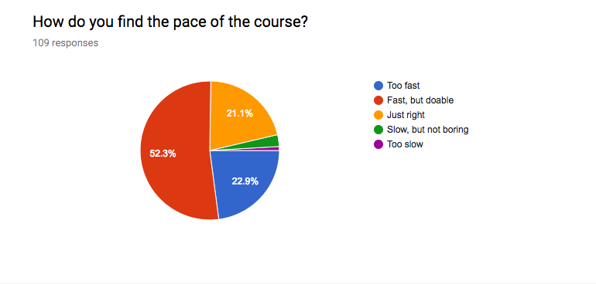
Week 3 Feedback

Slide 4
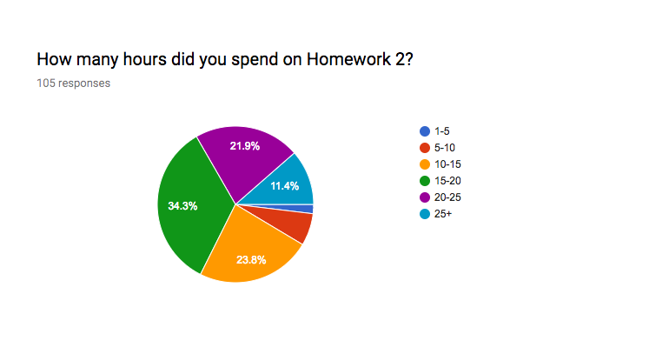
Week 3 Feedback

Slide 5
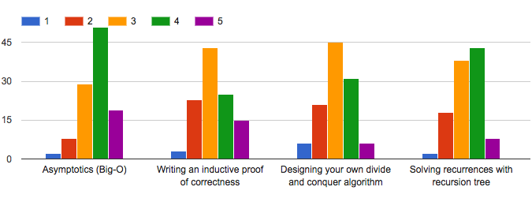
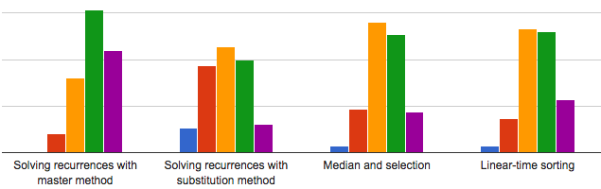
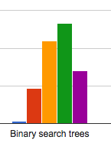
Week 3 Feedback

Slide 6
Week 3 Feedback
What's one thing that you like about the course so far?
Office hours are very helpful. Far fewer issues with office hours last week.
I am actually learning things! :O Yay!
I like radix sort. Me too!
What's one thing that you wish was different about the course so far?
More homework-related examples during lecture. Starting yesterday, I
converted half of my office hours into a discussion section.
Homework too long. Starting this week, we’ll ask 5 questions.
Point out the reference material that can help with the homework. Lecture
notes from previous quarters and CLRS chapters have been on the website
for the past two weeks.
More link to application of these algorithm. Starting this week, the
homework will be more applied and motivated.

Slide 7
Outline for Today
Graph algorithms
Graph Basics
DFS: topological sort, in-order traversal of BSTs, exact traversals
BFS: shortest paths, bipartite graph detection
Dijkstra’s Algorithm for single-source shortest path

Slide 8
Graph Basics

Slide 9
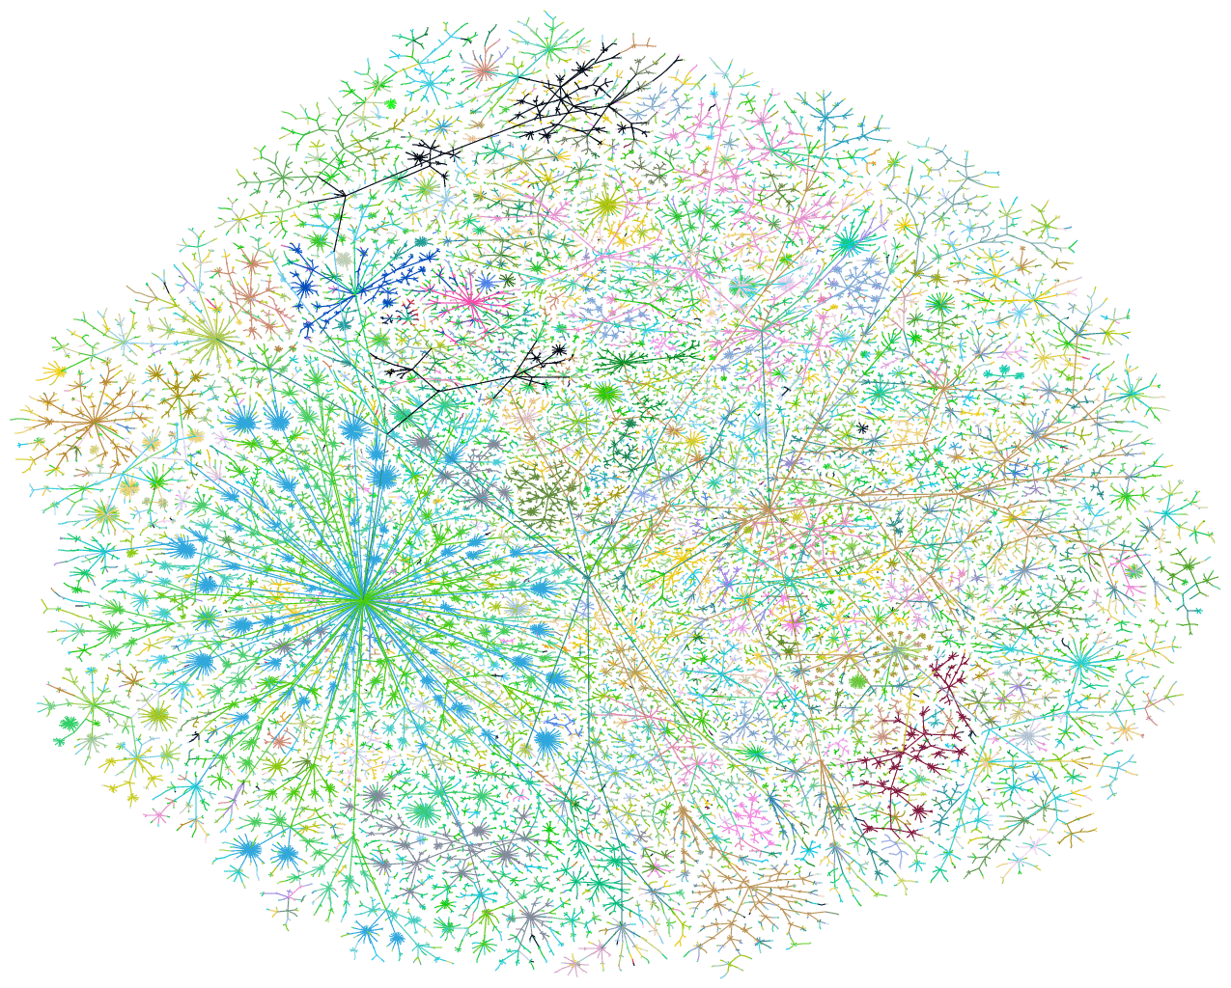
Examples of Graphs
The Internet (circa 1999)

Slide 10
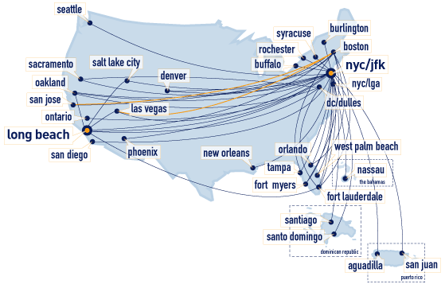
Examples of Graphs
Flight networks (Jet Blue, for example)

Slide 11
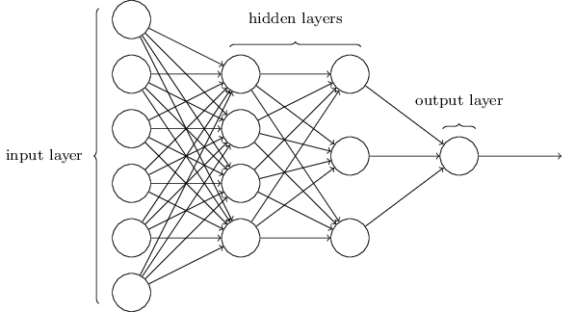
Examples of Graphs
Neural networks

Slide 12
Graphs
We might want to answer one of several questions about G.
Finding the shortest path between two vertices (SPSP) for efficient routing.
Finding strongly connected components for community detection or clustering.
Finding the topological ordering to respect dependencies.

Slide 13
Undirected Graphs
An undirected graph has vertices and edges.
V is the set of vertices and E is the set of edges.
Formally, an undirected graph is G = (V, E).
e.g. V = {A, B, C, D} and E = { {A, B}, {A, C}, {A, D}, {B, C}, {C, D} }
A
D
B
C

Slide 14
Directed Graphs
A directed graph has vertices and directed edges.
V is the set of vertices and E is the set of directed edges.
Formally, a directed graph is G = (V, E)
e.g. V = {A, B, C, D} and E = { [A, B], [A, D], [B, C], [C, A], [D, A], [D, C] }
A
D
B
C

Slide 15
Graph Representations
How do we represent graphs?
(1) Adjacency matrix
A
A B C D
0 1 1 1
1 0 1 0
1 1 0 1
1 0 1 0
A
B
C
D
D
B
C

Slide 16
Graph Representations
How do we represent graphs?
(1) Adjacency matrix
destination
A
A B C D
0 1 0 1
0 0 1 0
1 0 0 0
1 0 1 0
A
B
C
D
D
B
source
C

Slide 17
Graph Representations
How do we represent graphs?
(1) Adjacency matrix
(2) Adjacency list
A
A B C D
D
B
B
C
A
A
C
D
C

Slide 18
Graph Representations
For G = (V, E)
0 1 0 1
0 0 1 0
1 0 0 0
1 0 1 0
Generally, better for sparse graphs.
We’ll assume this representation, unless otherwise stated.
Edge Membership
Is e = {u, v} in E?
O(1)
O(deg(u))
or
O(deg(v))
Neighbor Query
What are the neighbors of u?
O(|V|)
O(deg(v))
Space requirements
O(|V|²)
O(|V|+|E|)

Slide 19
Depth-First Search

Slide 20
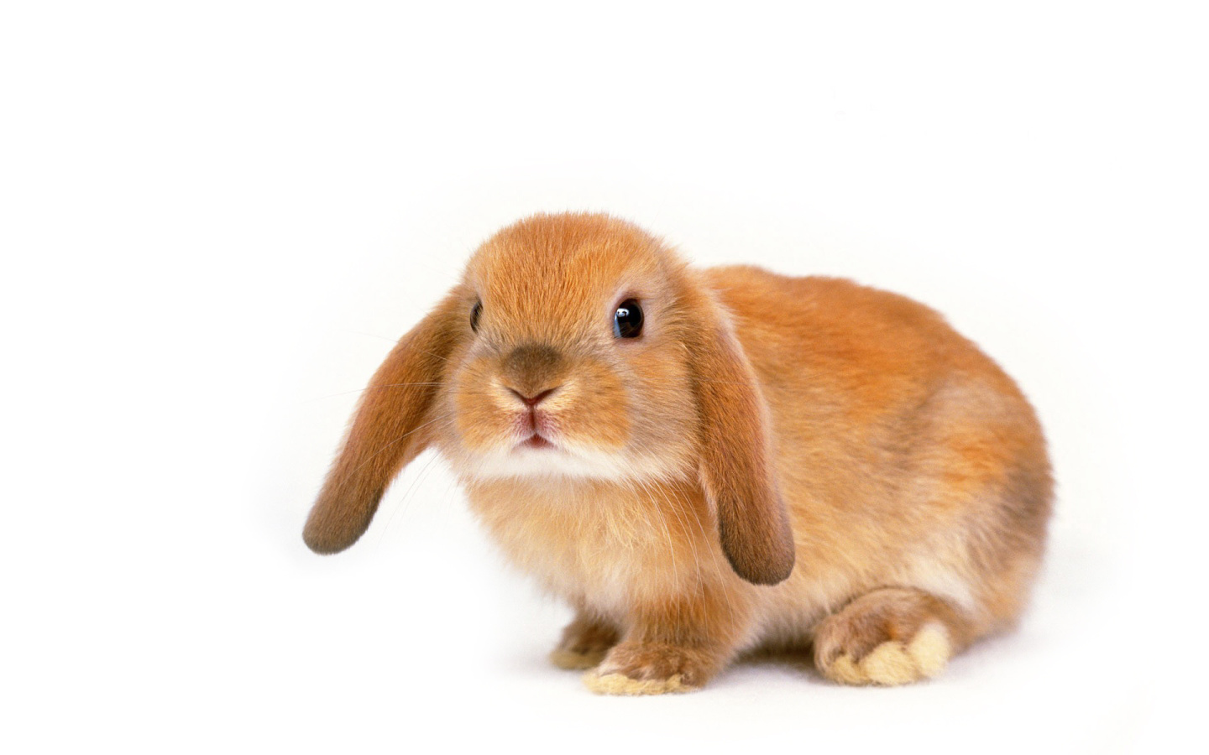
Depth-First Search
An analogy
A smart bunny exploring a labyrinth with chalk (to mark visited destinations)
and thread (to retrace steps).
s
unvisited
visited, but not fully explored
visited, and fully explored

Slide 21
Depth-First Search
An analogy
A smart bunny exploring a labyrinth with chalk (to mark visited destinations)
and thread (to retrace steps).
s
unvisited
visited, but not fully explored
visited, and fully explored

Slide 22
Depth-First Search
An analogy
A smart bunny exploring a labyrinth with chalk (to mark visited destinations)
and thread (to retrace steps).
s
unvisited
visited, but not fully explored
visited, and fully explored

Slide 23
Depth-First Search
An analogy
A smart bunny exploring a labyrinth with chalk (to mark visited destinations)
and thread (to retrace steps).
s
unvisited
visited, but not fully explored
visited, and fully explored

Slide 24
Depth-First Search
An analogy
A smart bunny exploring a labyrinth with chalk (to mark visited destinations)
and thread (to retrace steps).
s
unvisited
visited, but not fully explored
visited, and fully explored

Slide 25
Depth-First Search
An analogy
A smart bunny exploring a labyrinth with chalk (to mark visited destinations)
and thread (to retrace steps).
s
unvisited
visited, but not fully explored
visited, and fully explored

Slide 26
Depth-First Search
An analogy
A smart bunny exploring a labyrinth with chalk (to mark visited destinations)
and thread (to retrace steps).
s
unvisited
visited, but not fully explored
visited, and fully explored

Slide 27
Depth-First Search
An analogy
A smart bunny exploring a labyrinth with chalk (to mark visited destinations)
and thread (to retrace steps).
s
unvisited
visited, but not fully explored
visited, and fully explored

Slide 28
Depth-First Search
An analogy
A smart bunny exploring a labyrinth with chalk (to mark visited destinations)
and thread (to retrace steps).
s
unvisited
visited, but not fully explored
visited, and fully explored

Slide 29
Depth-First Search
An analogy
A smart bunny exploring a labyrinth with chalk (to mark visited destinations)
and thread (to retrace steps).
s
unvisited
visited, but not fully explored
visited, and fully explored

Slide 30
Depth-First Search
An analogy
A smart bunny exploring a labyrinth with chalk (to mark visited destinations)
and thread (to retrace steps).
s
unvisited
visited, but not fully explored
visited, and fully explored

Slide 31
Depth-First Search
An analogy
A smart bunny exploring a labyrinth with chalk (to mark visited destinations)
and thread (to retrace steps).
s
unvisited
visited, but not fully explored
visited, and fully explored

Slide 32
Depth-First Search
An analogy
A smart bunny exploring a labyrinth with chalk (to mark visited destinations)
and thread (to retrace steps).
s
unvisited
visited, but not fully explored
visited, and fully explored

Slide 33
Depth-First Search
An analogy
A smart bunny exploring a labyrinth with chalk (to mark visited destinations)
and thread (to retrace steps).
s
unvisited
visited, but not fully explored
visited, and fully explored

Slide 34
Depth-First Search
An analogy
A smart bunny exploring a labyrinth with chalk (to mark visited destinations)
and thread (to retrace steps).
s
unvisited
visited, but not fully explored
visited, and fully explored

Slide 35
Depth-First Search
An analogy
A smart bunny exploring a labyrinth with chalk (to mark visited destinations)
and thread (to retrace steps).
s
unvisited
visited, but not fully explored
visited, and fully explored

Slide 36
Depth-First Search
An analogy
A smart bunny exploring a labyrinth with chalk (to mark visited destinations)
and thread (to retrace steps).
s
unvisited
visited, but not fully explored
visited, and fully explored

Slide 37
Depth-First Search
An analogy
A smart bunny exploring a labyrinth with chalk (to mark visited destinations)
and thread (to retrace steps).
s
unvisited
visited, but not fully explored
visited, and fully explored

Slide 38
Depth-First Search
An analogy
A smart bunny exploring a labyrinth with chalk (to mark visited destinations)
and thread (to retrace steps).
s
unvisited
visited, but not fully explored
visited, and fully explored

Slide 39
Depth-First Search
An analogy
A smart bunny exploring a labyrinth with chalk (to mark visited destinations)
and thread (to retrace steps).
s
unvisited
visited, but not fully explored
visited, and fully explored

Slide 40
Depth-First Search
An analogy
A smart bunny exploring a labyrinth with chalk (to mark visited destinations)
and thread (to retrace steps).
s
unvisited
visited, but not fully explored
visited, and fully explored

Slide 41
Depth-First Search
algorithm dfs(u, cur_time):
u.start_time = cur_time
cur_time += 1
u.status = "in_progress"
for v in u.neighbors:
if v.status is "unvisited":
cur_time = dfs(v, cur_time)
cur_time += 1
u.end_time = cur_time
u.status = "done"
return cur_time
Runtime: O(|V|+|E|)

Slide 42
Depth-First Search
start_time: 0
s

Slide 43
Depth-First Search
start_time: 1
end_time: 12
start_time: 0
s

Slide 44
Depth-First Search
start_time: 1
end_time: 12
st: 4
et: 5
st: 3
et: 8
start_time: 0
s
st: 6
et: 7
st: 9
et: 10
st: 2
et: 11

Slide 45
Depth-First Search
start_time: 1
end_time: 12
st: 4
et: 5
st: 3
et: 8
start_time: 0
s
st: 6
et: 7
st: 9
et: 10
st: 2
et: 11

Slide 46
Depth-First Search
start_time: 1
end_time: 12
st: 4
et: 5
st: 3
et: 8
start_time: 0
s
st: 6
et: 7
st: 9
et: 10
st: 2
et: 11

Slide 47
Depth-First Search
start_time: 1
end_time: 12
st: 4
et: 5
st: 3
et: 8
start_time: 0
s
st: 6
et: 7
start_time: 13
start_time: 14
st: 9
et: 10
st: 2
et: 11

Slide 48
Depth-First Search
start_time: 1
end_time: 12
st: 4
et: 5
st: 3
et: 8
start_time: 0
s
st: 6
et: 7
start_time: 13
end_time: 14
st: 9
et: 10
st: 2
et: 11

Slide 49
Depth-First Search
start_time: 1
end_time: 12
st: 4
et: 5
st: 3
et: 8
start_time: 0
end_time: 15
s
st: 6
et: 7
start_time: 13
end_time: 14
st: 9
et: 10
st: 2
et: 11

Slide 50
Depth-First Search
DFS finds all vertices reachable from the starting point, called a connected component.
DFS works fine on directed graphs as well.
e.g. From u, only visit v₁ not v₂.
u
v₁
v₂

Slide 51
Topological Ordering

Slide 52

Aside: Directed Acyclic Graphs
A dependency graph is an instantiation of a directed acyclic graph (DAG) i.e. a directed graph with no directed cycles.
Which of these graphs are valid DAGs?

Slide 53
Aside: Directed Acyclic Graphs
A dependency graph is an instantiation of a directed acyclic graph (DAG) i.e. a directed graph with no directed cycles.
Which of these graphs are valid DAGs?

Slide 54
Topological Ordering
Application of DFS: Given a package dependency graph, in what order should packages be installed?
DFS produces a topological ordering, which solves this problem.
Definition: The topological ordering of a DAG is an ordering of its vertices
such that for every directed edge (u, v) ∈ E, u precedes v in the ordering.

Slide 55
Topological Ordering
Application of DFS: Given a package dependency graph, in what order should packages be installed?
DFS produces a topological ordering, which solves this problem.
Definition: The topological ordering of a DAG is an ordering of its vertices
such that for every directed edge (u, v) ∈ E, u precedes v in the ordering.
mongoose
Sometimes it’s possible to topologically order the vertices by hand.
async
mongodb
rimraf
bson
bluebird
A
B
nyc
means A depends on B i.e. install B before A.

Slide 56
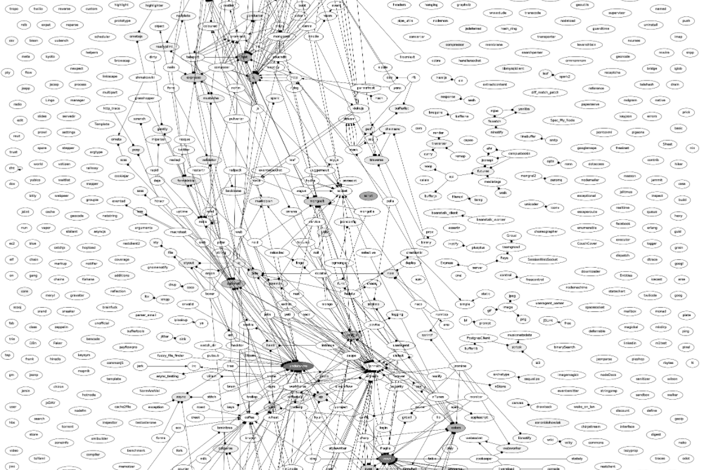
Topological Ordering
Application of DFS: Given a package dependency graph, in what order should packages be installed?
DFS produces a topological ordering, which solves this problem.
Definition: The topological ordering of a DAG is an ordering of its vertices
such that for every directed edge (u, v) ∈ E, u precedes v in the ordering.
Sometimes it’s not …

Slide 57
Topological Ordering
Claim: If (u, v) ∈ E, then end_time of u > end_time of v.
Intuition: dfs visits and finishes with all of the neighbors
of u before finishing u itself. Also, a DAG does not have
cycles, so dfs will never traverse to an in-progress vertex
(only unvisited and done vertices).

Slide 58
Topological Ordering
algorithm dfs(u, cur_time):
u.start_time = cur_time
cur_time += 1
u.status = "in_progress"
for v in u.neighbors:
if v.status is "unvisited":
cur_time = dfs(v, cur_time)
cur_time += 1
u.end_time = cur_time
u.status = "done"
return cur_time
Runtime: O(|V|+|E|)

Slide 59
Topological Ordering
reversed_topological_list = []
algorithm dfs(u, cur_time):
u.start_time = cur_time
cur_time += 1
u.status = "in_progress"
for v in u.neighbors:
if v.status is "unvisited":
cur_time = dfs(v, cur_time)
cur_time += 1
u.end_time = cur_time
u.status = "done"
reversed_topological_list.append(u)
return cur_time
Runtime: O(|V|+|E|)

Slide 60
Topological Ordering
For the package dependency graph, packages should be installed in reverse topological order, so we can just return reversed_topological_list.
To compute the topological ordering in general, reverse the order of reversed_topological_list.
e.g. Finding an order to take courses that satisfies prerequisites.
106A
109
103
106B
161
107
108
110
142

Slide 61
In-Order Traversal of BSTs
Application of DFS: Given a BST, output the vertices in order.
5
3
6
2
4
7
1

Slide 62

Exact Traversals of Graphs
Application of DFS: Find an exact traversal, a path that touches all vertices exactly once.
Suppose I deliver pizzas in SF. My route has 6 stops but since I bike and the
terrain is hilly, I can only bike from one stop to another in one direction. Can
I plan the most efficient route that visits each destination once?

Slide 63
Breadth-First Search

Slide 64
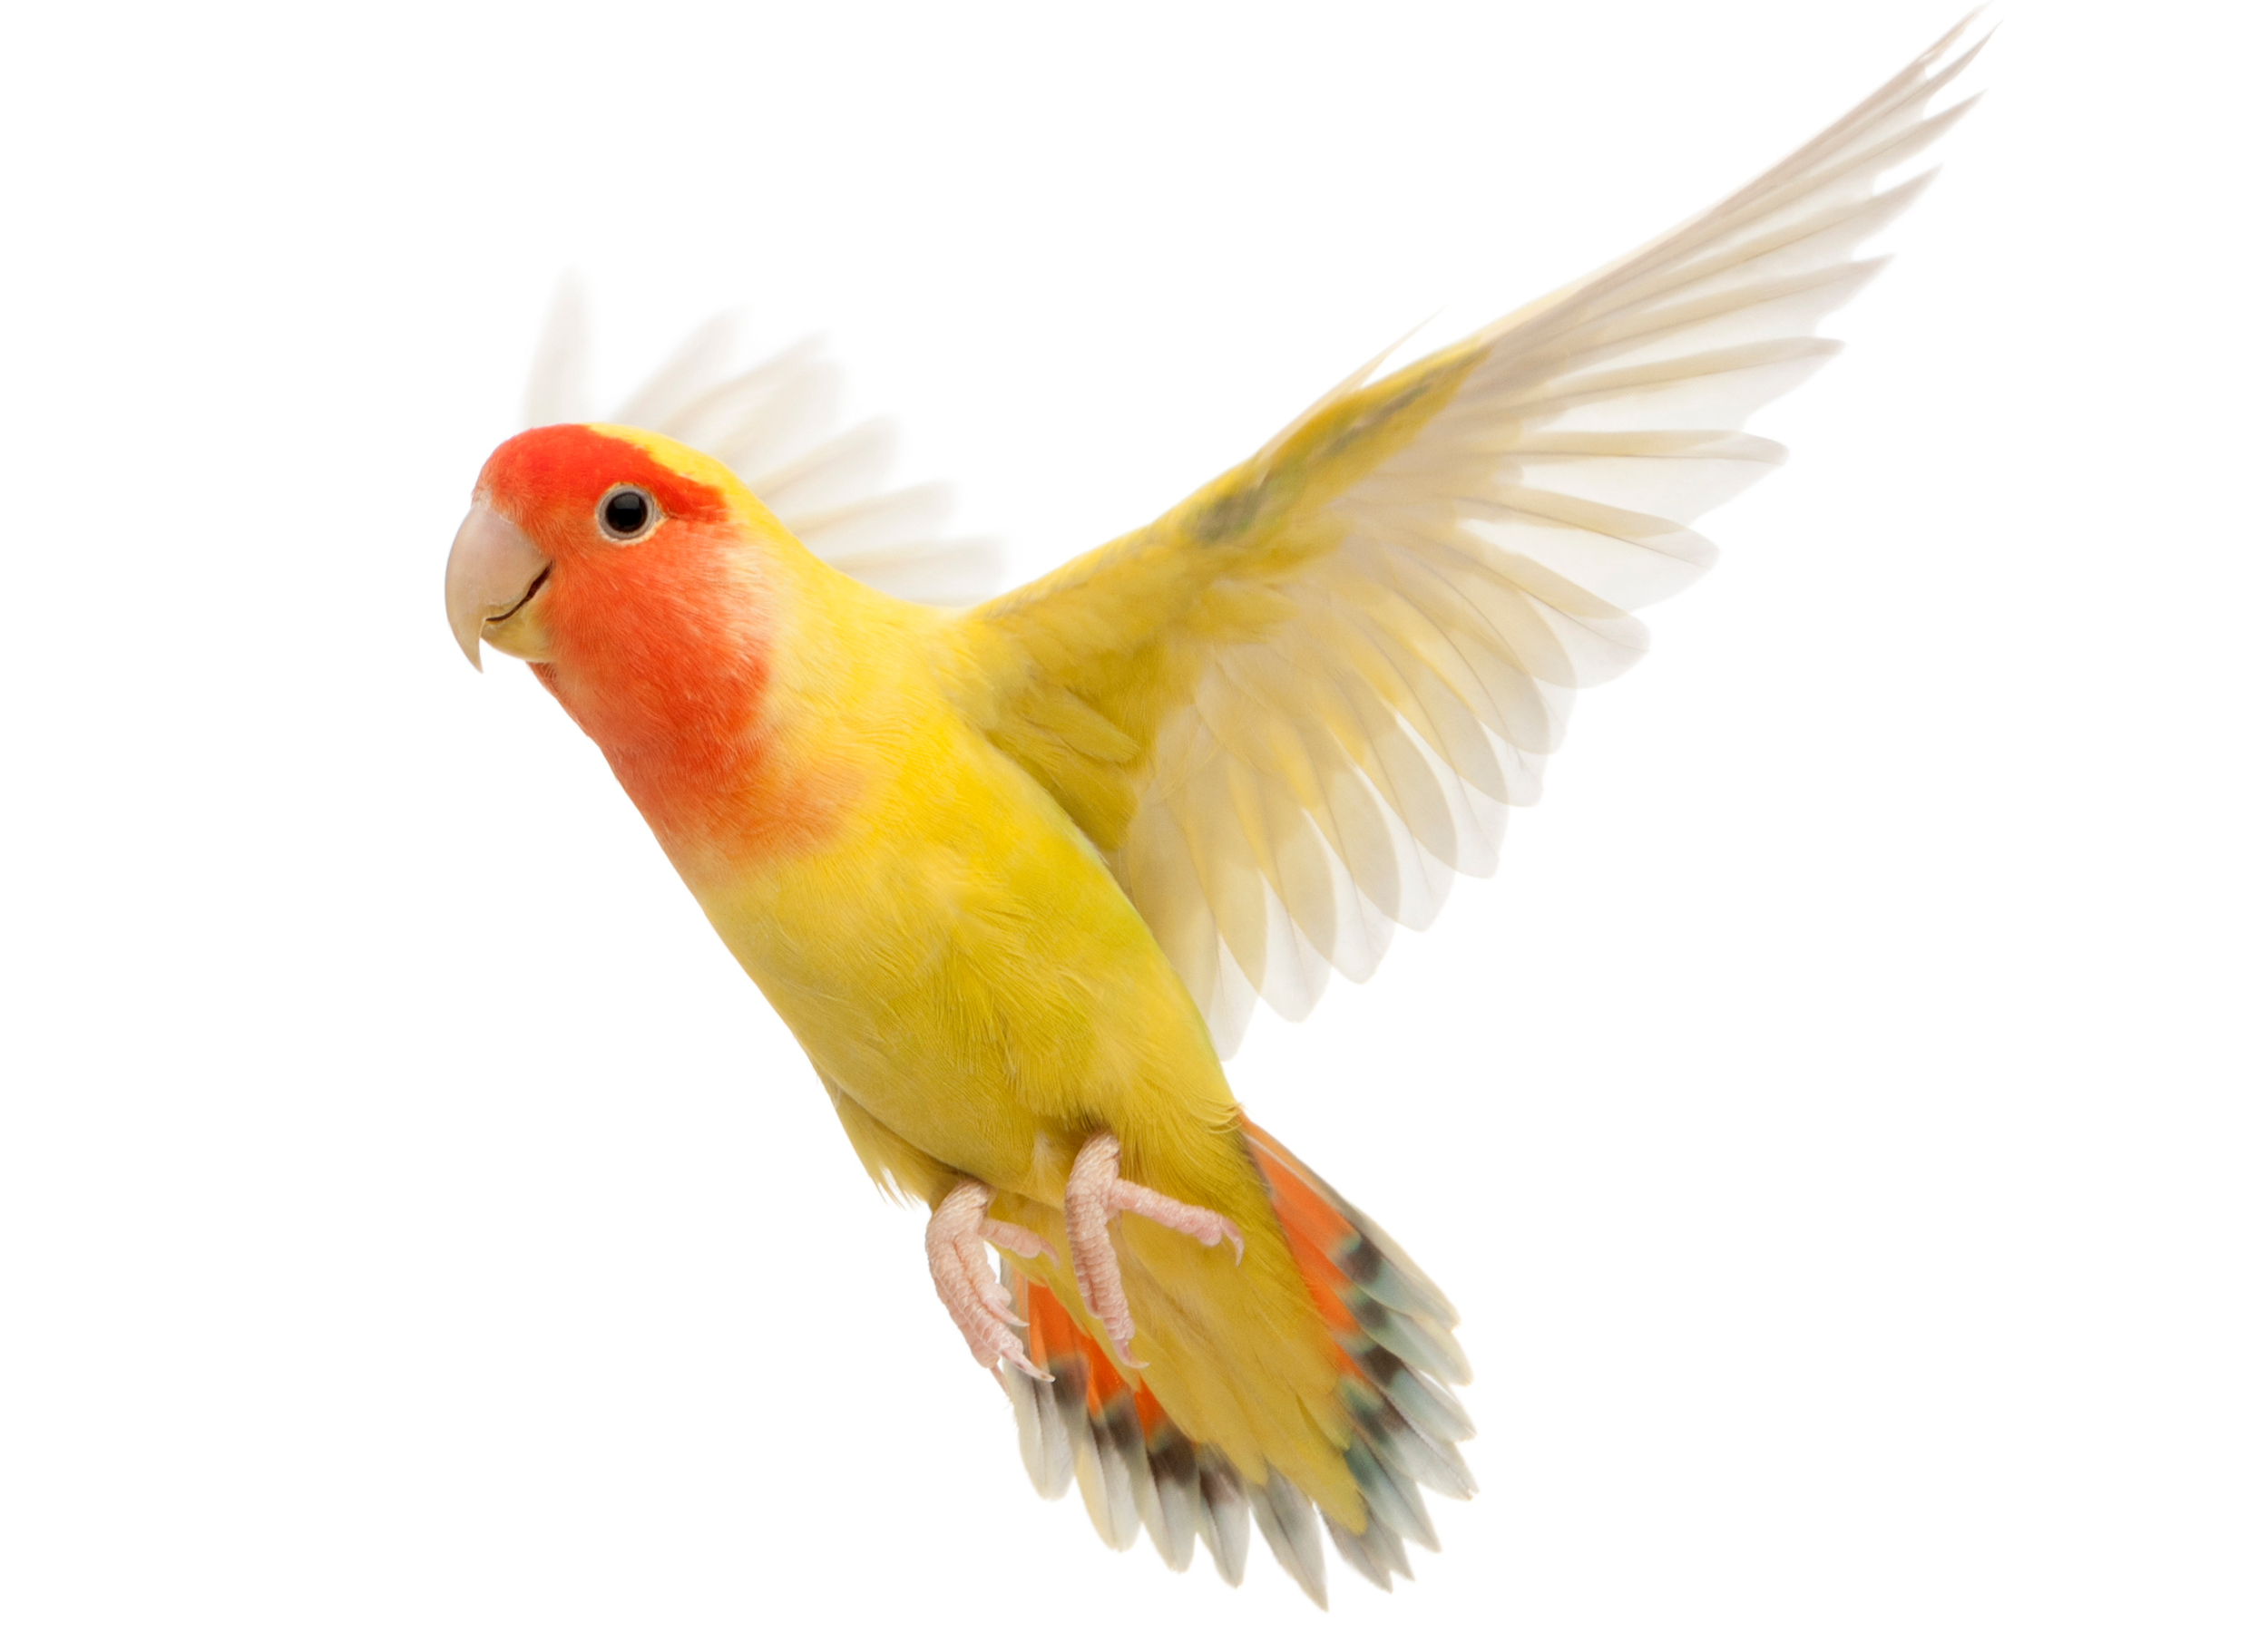
Breadth-First Search
An analogy
A bird exploring a labyrinth from above (with a bird’s eye view).
unvisited
reachable in
0 steps
reachable in
1 steps
reachable in
2 steps
reachable in
3 steps
s

Slide 65
Breadth-First Search
An analogy
A bird exploring a labyrinth from above (with a bird’s eye view).
unvisited
reachable in
0 steps
reachable in
1 steps
reachable in
2 steps
reachable in
3 steps
s

Slide 66
Breadth-First Search
An analogy
A bird exploring a labyrinth from above (with a bird’s eye view).
unvisited
reachable in
0 steps
reachable in
1 steps
reachable in
2 steps
reachable in
3 steps
s

Slide 67
Breadth-First Search
An analogy
A bird exploring a labyrinth from above (with a bird’s eye view).
unvisited
reachable in
0 steps
reachable in
1 steps
reachable in
2 steps
reachable in
3 steps
s

Slide 68
Breadth-First Search
algorithm bfs(s):
L = []
for i = 0 to n-1:
L[i] = {}
L[0] = {s}
for i = 0 to n-1:
for u in L[i]:
for v in u.neighbors:
if v.status is "unvisited":
v.status = "visited"
L[i+1].add(v)
Runtime: O(|V|+|E|)

Slide 69
Shortest Path
Application of BFS: How long is the shortest path between
vertices u and v?
Call bfs(u).
For all vertices in L[i], the shortest path between u and these vertices has
length i.
If v isn’t in L[i] for any i, then it’s unreachable from u.

Slide 70
Aside: Bipartiteness
A graph is bipartite iff there exists a two-coloring such that there are no edges between same-colored vertices.
e.g. Matching university hackathon guests and hosts.

Slide 71
Shortest Path
Application of BFS: Is a graph bipartite?
Call bfs from any vertex and color vertices alternating colors.
If it attempts to color the same vertex different colors, then the graph isn’t
bipartite; otherwise it is.
s

Slide 72
Shortest Path
Application of BFS: Is a graph bipartite?
Call bfs from any vertex and color vertices alternating colors.
If it attempts to color the same vertex different colors, then the graph isn’t
bipartite; otherwise it is.
s

Slide 73
Shortest Path
Application of BFS: Is a graph bipartite?
Call bfs from any vertex and color vertices alternating colors.
If it attempts to color the same vertex different colors, then the graph isn’t
bipartite; otherwise it is.
s

Slide 74
Shortest Path
Application of BFS: Is a graph bipartite?
Call bfs from any vertex and color vertices alternating colors.
If it attempts to color the same vertex different colors, then the graph isn’t
bipartite; otherwise it is.
s
BIPARTITE!

Slide 75
Shortest Path
Application of BFS: Is a graph bipartite?
Call bfs from any vertex and color vertices alternating colors.
If it attempts to color the same vertex different colors, then the graph isn’t
bipartite; otherwise it is.
s

Slide 76
Shortest Path
Application of BFS: Is a graph bipartite?
Call bfs from any vertex and color vertices alternating colors.
If it attempts to color the same vertex different colors, then the graph isn’t
bipartite; otherwise it is.
s

Slide 77
Shortest Path
Application of BFS: Is a graph bipartite?
Call bfs from any vertex and color vertices alternating colors.
If it attempts to color the same vertex different colors, then the graph isn’t
bipartite; otherwise it is.
s

Slide 78
Shortest Path
Application of BFS: Is a graph bipartite?
Call bfs from any vertex and color vertices alternating colors.
If it attempts to color the same vertex different colors, then the graph isn’t
bipartite; otherwise it is.
s
NOT BIPARTITE!

Slide 79
Shortest Path
Application of BFS: Is a graph bipartite?
Call bfs from any vertex and color vertices alternating colors.
If it attempts to color the same vertex different colors, then the graph isn’t
bipartite; otherwise it is.
Is anyone incredulous that this actually works?
s
NOT BIPARTITE!

Slide 80
Shortest Path
There exist many poor colorings on legitimate bipartite graphs.
Just because this coloring that doesn’t work, why does that mean that
no coloring works?
This is a poor coloring on an obviously bipartite graph.

Slide 81
Shortest Path
Theorem: bfs colors two neighbors the same color iff the graph is not bipartite.
Proof:
Since bfs colors vertices alternating colors, it colors two neighbors the same
color iff it’s found a cycle of odd length in the graph. Therefore, the graph
contains an odd cycle as a subgraph. But it’s impossible to color an odd cycle
with two colors such that no two neighbors have the same color. Therefore,
it’s impossible to two-color the graph such that the no edges between
same-colored vertices, and the graph must not be bipartite.

Slide 82
3 min break

Slide 83
Dijkstra’s Algorithm

Slide 84
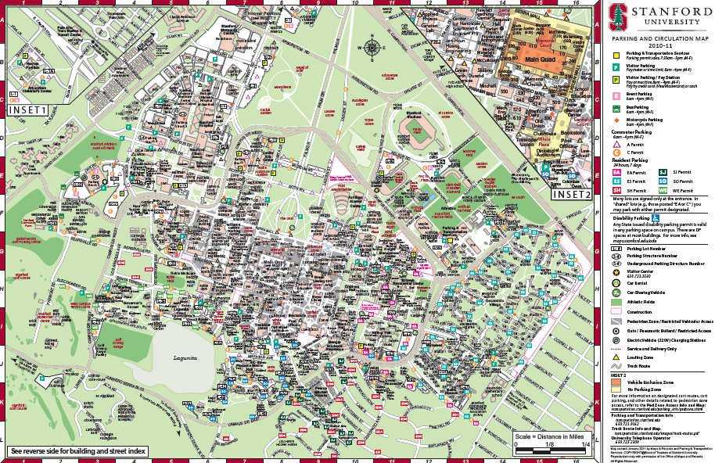
Shortest Path
Suppose you’re new to campus and only know paths between certain landmarks.
Caltrain
Foster Field
Gates
Memchu
Panda Express
Stern Dining
Old Union
The Dish

Slide 85
Shortest Path
Caltrain
What’s the shortest path from Gates
to Old Union?
BFS says via The Dish.
This is a weighted graph w(u, v) represents the weight of edge (u, v).
For now, these weights are non-negative.
4
12
Foster Field
3
Gates
15
2
Memchu
2
10
Panda Express
21
Stern Dining
1
Old Union
15
The Dish

Slide 86
Shortest Path
What is the shortest path between u and v in a weighted graph?
The cost of a path is the sum of the weights along that path.
The shortest path is the one with the minimum cost.
Gates
2
This path from Gates to Old Union has cost 36.
Memchu
2
21
Stern Dining
1
Old Union
Old Union
15
The Dish

Slide 87
Shortest Path
What is the shortest path between u and v in a weighted graph?
The cost of a path is the sum of the weights along that path.
The shortest path is the one with the minimum cost.
Gates
2
This path from Gates to Old Union has cost 5.
Memchu
2
21
Stern Dining
1
Old Union
Old Union
All graphs are directed, but to save the trouble of drawing double arrows everywhere:
=
15
The Dish

Slide 88
Shortest Path
Claim: A subpath of a shortest path is also a shortest path.
Intuition:
Suppose this is a shortest path from s to t.
…
s
t

Slide 89
Shortest Path
Claim: A subpath of a shortest path is also a shortest path.
Intuition:
Suppose this is a shortest path from s to t.
Then this is a shortest path from s to x.
Why?
…
s
x
t

Slide 90
Shortest Path
Claim: A subpath of a shortest path is also a shortest path.
Intuition:
Suppose this is a shortest path from s to t.
Then this is a shortest path from s to x.
Why?
…
s
x
t

Slide 91
Shortest Path
Claim: A subpath of a shortest path is also a shortest path.
Intuition:
Suppose this is a shortest path from s to t.
Then this is a shortest path from s to x.
Why? By contradiction, suppose there exists a shorter path from s to x,
namely this one.
…
s
x
t
…

Slide 92
Shortest Path
Claim: A subpath of a shortest path is also a shortest path.
Intuition:
Suppose this is a shortest path from s to t.
Then this is a shortest path from s to x.
Why? By contradiction, suppose there exists a shorter path from s to x,
namely this one.
But then this is shorter than this shortest path from s to t.
…
s
x
t
…

Slide 93
Single-Source Shortest Path
∞
Caltrain
Destination Cost
Memchu 2
Foster Field 3
Caltrain 7
The Dish 20
Stern Dining 4
Old Union 5
Panda 14
4
12
∞
Foster Field
3
0
15
Gates
2
∞
Memchu
∞
2
∞
10
Panda Express
21
Stern Dining
1
Old Union
∞
15
The Dish
∞

Slide 94
Single-Source Shortest Path
Application: Finding the shortest path from Palo Alto to [somewhere else] for a commuter using BART, Caltrain, bike, walking, Uber, Lyft, etc.
Edge weights are a function of time, money, hassle that change depending on
the commuter’s mood on that day.
Application: Finding the shortest path from my computer to the desired server for packets using the Internet.
Edge weights are a function of link length, traffic, other costs, etc.

Slide 95
Dijkstra’s Algorithm
Dijkstra’s Algorithm solves the single-source shortest path problem.

Slide 96
Dijkstra’s Algorithm
∞
Caltrain
Update all u’s neighbors v as follows:
d[v] = min(d[v], d[u] + w(u, v))
4
12
∞
Foster Field
3
0
15
Gates
2
∞
Memchu
∞
2
∞
10
Panda Express
21
Stern Dining
1
Old Union
∞
15
The Dish
∞

Slide 97
Dijkstra’s Algorithm
12
Caltrain
Update all u’s neighbors v as follows:
d[v] = min(d[v], d[u] + w(u, v))
4
12
3
Foster Field
3
0
15
Gates
2
2
Memchu
∞
2
∞
10
Panda Express
21
Stern Dining
1
Old Union
∞
15
The Dish
21

Slide 98
Dijkstra’s Algorithm
12
Caltrain
Update all u’s neighbors v as follows:
d[v] = min(d[v], d[u] + w(u, v))
4
12
3
Foster Field
3
0
15
Gates
2
2
Memchu
∞
2
∞
10
Panda Express
21
Stern Dining
1
Old Union
∞
15
The Dish
21

Slide 99
Dijkstra’s Algorithm
12
Caltrain
Update all u’s neighbors v as follows:
d[v] = min(d[v], d[u] + w(u, v))
4
12
3
Foster Field
3
0
15
Gates
2
2
Memchu
∞
2
∞
10
Panda Express
21
Stern Dining
1
Old Union
∞
15
The Dish
21

Slide 100
Dijkstra’s Algorithm
12
Caltrain
Update all u’s neighbors v as follows:
d[v] = min(d[v], d[u] + w(u, v))
4
12
3
Foster Field
3
0
15
Gates
2
2
Memchu
∞
2
∞
10
Panda Express
21
Stern Dining
1
Old Union
∞
15
The Dish
21

Slide 101
Dijkstra’s Algorithm
12
Caltrain
Update all u’s neighbors v as follows:
d[v] = min(d[v], d[u] + w(u, v))
4
12
3
Foster Field
3
0
15
Gates
2
2
Memchu
∞
2
4
10
Panda Express
21
Stern Dining
1
Old Union
∞
15
The Dish
21

Slide 102
Dijkstra’s Algorithm
12
Caltrain
Update all u’s neighbors v as follows:
d[v] = min(d[v], d[u] + w(u, v))
4
12
3
Foster Field
3
0
15
Gates
2
2
Memchu
∞
2
4
10
Panda Express
21
Stern Dining
1
Old Union
∞
15
The Dish
21

Slide 103
Dijkstra’s Algorithm
12
Caltrain
Update all u’s neighbors v as follows:
d[v] = min(d[v], d[u] + w(u, v))
4
12
3
Foster Field
3
0
15
Gates
2
2
Memchu
∞
2
4
10
Panda Express
21
Stern Dining
1
Old Union
∞
15
The Dish
21

Slide 104
Dijkstra’s Algorithm
12
d[Caltrain] = min(12, 3 + 4)
Caltrain
Update all u’s neighbors v as follows:
d[v] = min(d[v], d[u] + w(u, v))
4
12
3
Foster Field
3
0
15
Gates
2
2
Memchu
∞
2
4
10
Panda Express
21
Stern Dining
1
Old Union
∞
15
The Dish
21

Slide 105
Dijkstra’s Algorithm
7
Caltrain
Update all u’s neighbors v as follows:
d[v] = min(d[v], d[u] + w(u, v))
4
12
3
Foster Field
3
0
15
Gates
2
2
Memchu
18
2
4
10
Panda Express
21
Stern Dining
1
Old Union
∞
15
The Dish
21

Slide 106
Dijkstra’s Algorithm
7
Caltrain
Update all u’s neighbors v as follows:
d[v] = min(d[v], d[u] + w(u, v))
4
12
3
Foster Field
3
0
15
Gates
2
2
Memchu
18
2
4
10
Panda Express
21
Stern Dining
1
Old Union
∞
15
The Dish
21

Slide 107
Dijkstra’s Algorithm
7
Caltrain
Update all u’s neighbors v as follows:
d[v] = min(d[v], d[u] + w(u, v))
4
12
3
Foster Field
3
0
15
Gates
2
2
Memchu
18
2
4
10
Panda Express
21
Stern Dining
1
Old Union
∞
15
The Dish
21

Slide 108
Dijkstra’s Algorithm
7
Caltrain
Update all u’s neighbors v as follows:
d[v] = min(d[v], d[u] + w(u, v))
4
12
3
Foster Field
3
0
15
Gates
2
2
Memchu
18
2
4
10
Panda Express
21
Stern Dining
1
Old Union
d[Panda Express] = min(18, 4 + 10)
∞
15
The Dish
21

Slide 109
Dijkstra’s Algorithm
7
Caltrain
Update all u’s neighbors v as follows:
d[v] = min(d[v], d[u] + w(u, v))
4
12
3
Foster Field
3
0
15
Gates
2
2
Memchu
14
2
4
10
Panda Express
21
Stern Dining
1
Old Union
5
15
The Dish
21

Slide 110
Dijkstra’s Algorithm
7
Caltrain
Update all u’s neighbors v as follows:
d[v] = min(d[v], d[u] + w(u, v))
4
12
3
Foster Field
3
0
15
Gates
2
2
Memchu
14
2
4
10
Panda Express
21
Stern Dining
1
Old Union
5
15
The Dish
21

Slide 111
Dijkstra’s Algorithm
7
Caltrain
Update all u’s neighbors v as follows:
d[v] = min(d[v], d[u] + w(u, v))
4
12
3
Foster Field
3
0
15
Gates
2
2
Memchu
14
2
4
10
Panda Express
21
Stern Dining
1
Old Union
5
15
The Dish
21

Slide 112
Dijkstra’s Algorithm
7
Caltrain
Update all u’s neighbors v as follows:
d[v] = min(d[v], d[u] + w(u, v))
4
12
3
Foster Field
3
0
15
Gates
2
2
Memchu
14
2
4
10
Panda Express
21
Stern Dining
1
Old Union
5
15
The Dish
21
d[The Dish] = min(21, 5 + 15)

Slide 113
Dijkstra’s Algorithm
7
Caltrain
Update all u’s neighbors v as follows:
d[v] = min(d[v], d[u] + w(u, v))
4
12
3
Foster Field
3
0
15
Gates
2
2
Memchu
14
2
4
10
Panda Express
21
Stern Dining
1
Old Union
5
15
The Dish
20

Slide 114
Dijkstra’s Algorithm
7
Caltrain
Update all u’s neighbors v as follows:
d[v] = min(d[v], d[u] + w(u, v))
4
12
3
Foster Field
3
0
15
Gates
2
2
Memchu
14
2
4
10
Panda Express
21
Stern Dining
1
Old Union
5
15
The Dish
20

Slide 115
Dijkstra’s Algorithm
7
Caltrain
Update all u’s neighbors v as follows:
d[v] = min(d[v], d[u] + w(u, v))
4
12
3
Foster Field
3
0
15
Gates
2
2
Memchu
14
2
4
10
Panda Express
21
Stern Dining
1
Old Union
5
15
The Dish
20

Slide 116
Dijkstra’s Algorithm
7
Caltrain
Update all u’s neighbors v as follows:
d[v] = min(d[v], d[u] + w(u, v))
4
12
3
Foster Field
3
0
15
Gates
2
2
Memchu
14
2
4
10
Panda Express
21
Stern Dining
1
Old Union
5
15
The Dish
20

Slide 117
Dijkstra’s Algorithm
Why does this work?
Let s be the single source.
Theorem: After running Dijkstra’s Algorithm, the estimate d[v] is the actual
distance d(s, v).
Proof Outline:
Claim 1: For all v, d[v] ≥ d(s, v).
Claim 2: When a vertex v gets marked “done”, d[v] = d(s, v).
Together, claims 1 and 2 imply the theorem.

Slide 118
Dijkstra’s Algorithm
Why does this work?
Let s be the single source.
Theorem: After running Dijkstra’s Algorithm, the estimate d[v] is the actual
distance d(s, v).
Proof Outline:
Claim 1: For all v, d[v] ≥ d(s, v).
Claim 2: When a vertex v gets marked “done”, d[v] = d(s, v).
Together, claims 1 and 2 imply the theorem.
d[v] never increases, so Claim 1 and 2 imply that d[v] weakly decreases
until d[v] = d(s, v) then never changes again.

Slide 119
Dijkstra’s Algorithm
Why does this work?
Let s be the single source.
Theorem: After running Dijkstra’s Algorithm, the estimate d[v] is the actual
distance d(s, v).
Proof Outline:
Claim 1: For all v, d[v] ≥ d(s, v).
Claim 2: When a vertex v gets marked “done”, d[v] = d(s, v).
Together, claims 1 and 2 imply the theorem.
d[v] never increases, so Claim 1 and 2 imply that d[v] weakly decreases
until d[v] = d(s, v) then never changes again.
By the time we’re sure about “done” about v, d[v] = d(s, v).

Slide 120
Dijkstra’s Algorithm
Why does this work?
Let s be the single source.
Theorem: After running Dijkstra’s Algorithm, the estimate d[v] is the actual
distance d(s, v).
Proof Outline:
Claim 1: For all v, d[v] ≥ d(s, v).
Claim 2: When a vertex v gets marked “done”, d[v] = d(s, v).
Together, claims 1 and 2 imply the theorem.
d[v] never increases, so Claim 1 and 2 imply that d[v] weakly decreases
until d[v] = d(s, v) then never changes again.
By the time we’re sure about “done” about v, d[v] = d(s, v).
All vertices are eventually “done” (stopping condition in algorithm).

Slide 121
Dijkstra’s Algorithm
Why does this work?
Let s be the single source.
Theorem: After running Dijkstra’s Algorithm, the estimate d[v] is the actual
distance d(s, v).
Proof Outline:
Claim 1: For all v, d[v] ≥ d(s, v).
Claim 2: When a vertex v gets marked “done”, d[v] = d(s, v).
Together, claims 1 and 2 imply the theorem.
d[v] never increases, so Claim 1 and 2 imply that d[v] weakly decreases
until d[v] = d(s, v) then never changes again.
By the time we’re sure about “done” about v, d[v] = d(s, v).
All vertices are eventually “done” (stopping condition in algorithm).
Therefore, all vertices end up with d[v] = d(s, v).

Slide 122
Dijkstra’s Algorithm
Why does this work?
Claim 1: For all v, d[v] ≥ d(s, v).
Proof:
We proceed by induction on t, the number of iterations completed
by the algorithm.

Slide 123
Dijkstra’s Algorithm
Why does this work?
Claim 1: For all v, d[v] ≥ d(s, v).
Proof:
We proceed by induction on t, the number of iterations completed
by the algorithm.
After t = 0 iterations, d(s, s) = 0 and d(s, v) ≤ ∞ which satisfy d[v] ≥ d(s, v).

Slide 124
Dijkstra’s Algorithm
Why does this work?
Claim 1: For all v, d[v] ≥ d(s, v).
Proof:
We proceed by induction on t, the number of iterations completed
by the algorithm.
After t = 0 iterations, d(s, s) = 0 and d(s, v) ≤ ∞ which satisfy d[v] ≥ d(s, v).
For the inductive step, suppose the inductive hypothesis holds for
iteration t.

Slide 125
Dijkstra’s Algorithm
Why does this work?
Claim 1: For all v, d[v] ≥ d(s, v).
Proof:
We proceed by induction on t, the number of iterations completed
by the algorithm.
After t = 0 iterations, d(s, s) = 0 and d(s, v) ≤ ∞ which satisfy d[v] ≥ d(s, v).
For the inductive step, suppose the inductive hypothesis holds for
iteration t. Then at iteration t + 1, the algorithm picks a vertex u and
for each of its neighbors v sets: d[v] = min(d[v], v[u] + w(u, v)) ≥ d(s, v).
Thus, the induction holds for t + 1.
By induction, d[v] ≥ d(s, v)
d(s, v) ≤ d(s, u) + d(u, v)
≤ d[u] + w(u, v)

Slide 126
Dijkstra’s Algorithm
Why does this work?
Claim 2: When a vertex v gets marked “done”, d[v] = d(s, v).
Proof:
We proceed by induction on t, the number of vertices marked as “done.”

Slide 127
Dijkstra’s Algorithm
Why does this work?
Claim 2: When a vertex v gets marked “done”, d[v] = d(s, v).
Proof:
We proceed by induction on t, the number of vertices marked as “done.”
For the base case, note that after s is marked as “done”, d[s] = d(s, s) = 0,
which satisfies d[v] = d(s, v).

Slide 128
Dijkstra’s Algorithm
Why does this work?
Claim 2: When a vertex v gets marked “done”, d[v] = d(s, v).
Proof:
We proceed by induction on t, the number of vertices marked as “done.”
For the base case, note that after s is marked as “done”, d[s] = d(s, s) = 0,
which satisfies d[v] = d(s, v).
For the inductive step, assume that for all vertices v already marked as
“done”, d[v] = d(s, v). Let x be the vertex with minimum distance estimate.
We must prove d[x] = d(s, x).

Slide 129
Dijkstra’s Algorithm
Why does this work?
Claim 2: When a vertex v gets marked “done”, d[v] = d(s, v).
Proof, cont.:
We proceed by contradiction. Suppose d[x] ≠d(s, x).

Slide 130
Dijkstra’s Algorithm
Why does this work?
Claim 2: When a vertex v gets marked “done”, d[v] = d(s, v).
Proof, cont.:
We proceed by contradiction. Suppose d[x] ≠d(s, x).
Let p be the shortest path from s to x. There must exist some z
on p such that d[z] = d(s, z). Let z be the closest such vertex to x.
We know d[z] = d(s, z) ≤ d(s, x) < d[x].
z must exist since,
at the very least, s is
part of the shortest
path, and d[s] = d(s, s).
Weights are non-negative.
Claim 1 implies d(s, x) ≤ d[x] and we assumed that d[x] ≠d(s, x).

Slide 131
Dijkstra’s Algorithm
Why does this work?
Claim 2: When a vertex v gets marked “done”, d[v] = d(s, v).
Proof, cont.:
We proceed by contradiction. Suppose d[x] ≠d(s, x).
Let p be the shortest path from s to x. There must exist some z
on p such that d[z] = d(s, z). Let z be the closest such vertex to x.
We know d[z] = d(s, z) ≤ d(s, x) < d[x].
Therefore, d[z] < d[x]. But this can’t be the case. Why not? Since d[z] < d[x]
and x is the vertex with minimum distance estimate, z must be already
marked “done.”
z must exist since,
at the very least, s is
part of the shortest
path, and d[s] = d(s, s).
Weights are non-negative.
Claim 1 implies d(s, x) ≤ d[x] and we assumed that d[x] ≠d(s, x).
Otherwise, z would be the vertex with minimum distance estimate.

Slide 132
Dijkstra’s Algorithm
Why does this work?
Claim 2: When a vertex v gets marked “done”, d[v] = d(s, v).
Proof, cont.:
Since z is already marked “done,” the edges out of z, including the edge (z, z’)
(where z’ is also on p) have been relaxed by the algorithm

Slide 133
Dijkstra’s Algorithm
Why does this work?
Claim 2: When a vertex v gets marked “done”, d[v] = d(s, v).
Proof, cont.:
Since z is already marked “done,” the edges out of z, including the edge (z, z’)
(where z’ is also on p) have been relaxed by the algorithm i.e.
d[z’] ≤ d(s, z) + w(z, z’) = d(s, z’) since z is on the shortest path from s to z’ and
the distance estimate of z’ must be correct.

Slide 134
Dijkstra’s Algorithm
Why does this work?
Claim 2: When a vertex v gets marked “done”, d[v] = d(s, v).
Proof, cont.:
Since z is already marked “done,” the edges out of z, including the edge (z, z’)
(where z’ is also on p) have been relaxed by the algorithm i.e.
d[z’] ≤ d(s, z) + w(z, z’) = d(s, z’) since z is on the shortest path from s to z’ and
the distance estimate of z’ must be correct.
However, this contradicts z being the closest vertex on p to x satisfying
d[z] = d(s, z). Thus, our assumption that d[z] < d[x] must be false, and it
follows that d[x] = d(s, x). ◾

